Slide 1

TRICS SYSTEM DEMONSTRATION – ADVANCED FEATURES
Harry Summerfield
Operations Officer
TRICS Consortium Ltd
Notes:
In this presentation, we will be looking at some more advanced features of the TRICS system as well as a worked example of a trip rate report using some parameters and more advanced features that some users may be unaware of. We will also look at a brief overview of the Travel Plan Monitoring Report feature of TRICS.

Slide 2
TRICS SYSTEM DEMONSTRATION – ADVANCED FEATURES
View saved work/audit numbers
Search feature in the Help section
A map of sites within the list sites page
Additional columns in the list sites page
Notes:
We will start by looking at some general features of the TRICS system that some users might not be fully aware of.

Slide 3
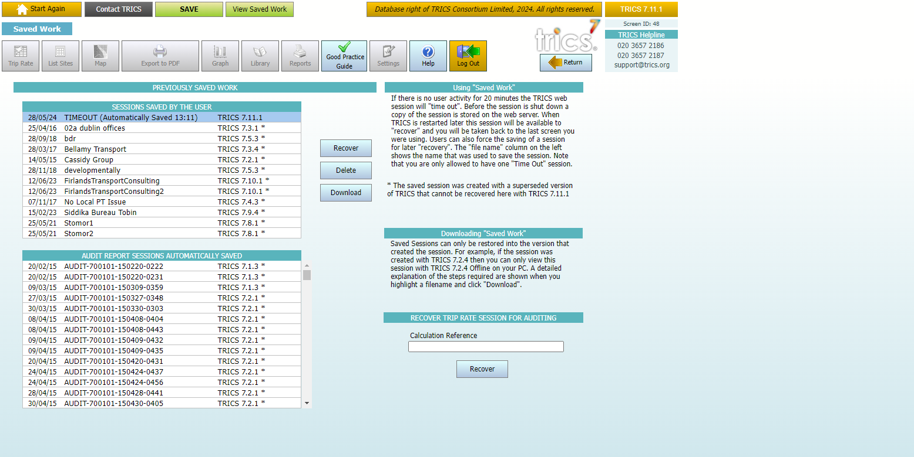
View Saved Work
Notes:
The first feature we will look at is the View Saved Work feature. This can be found at the top of the TRICS database Home Screen. Firstly, when a session times out, the user can find the automatically saved work within this feature under the Sessions Saved By User list. A user can then recover, delete, or download a session. The second feature is the Audit Recover feature. Each Trip Rate Report has an audit number that can be used to recover a session within the system. After inputting the reference in the ‘Calculate Reference’ box and clicking the Recover button, a user can recreate the session that was used to create the report, so long as the same version of TRICS that was used to create the original session is used to recreate it. The Audit feature can also be found on the TRICS Home Screen.

Slide 4
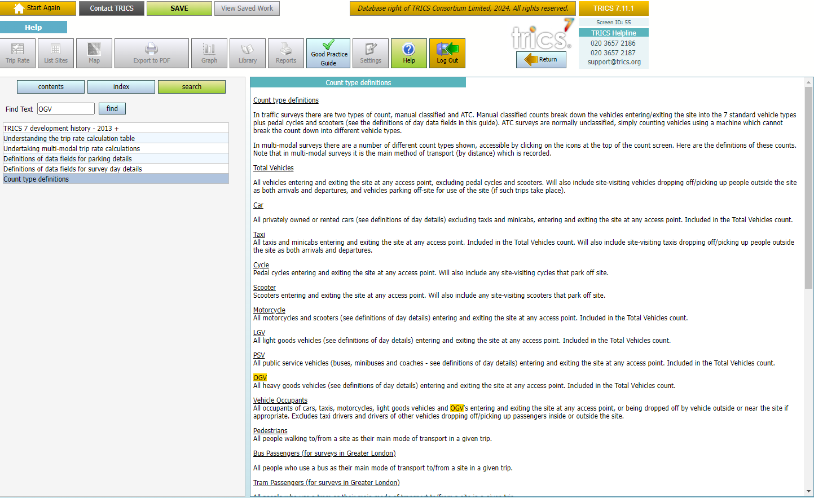
Help Search Feature
Notes:
Another helpful feature within TRICS is the Search button within the Help pages of the system. This can be used to find documents within the Help section a lot easier. For example, if you are looking for the definition of OGVs, you can simply type “OGV” into the search bar and all the documents that contain the text “OGV” will appear.

Slide 5
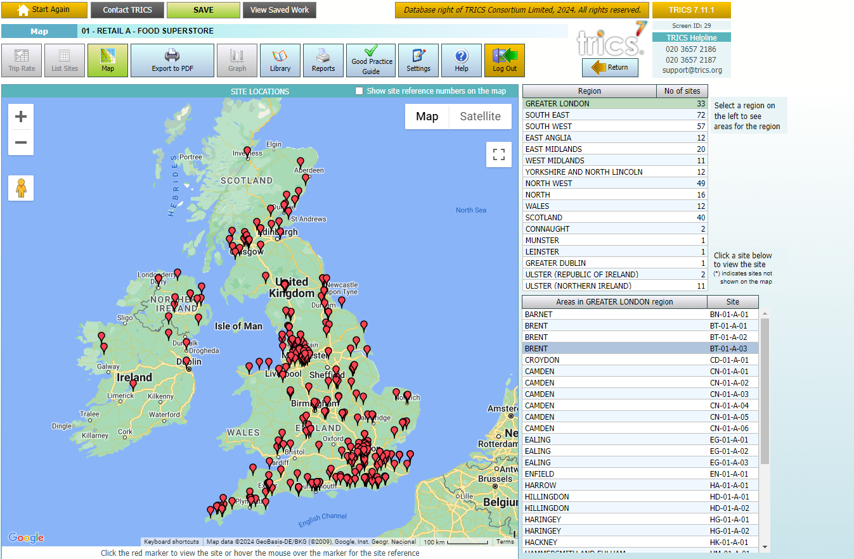
Map Feature in List Sites
Notes:
The next feature is found within the List Sites section of the database. You can use the Map feature if you want to know the general location of all TRICS sites within a land use sub-category or are looking for a site within a specific area. Currently, we are looking at Food Superstores and you can see on the map where the sites are located, a table that shows how many sites are in each region, and an alphabetical list by Site Reference Code of areas within Greater London, which can be changed by clicking on a selected region within the Region box.

Slide 6
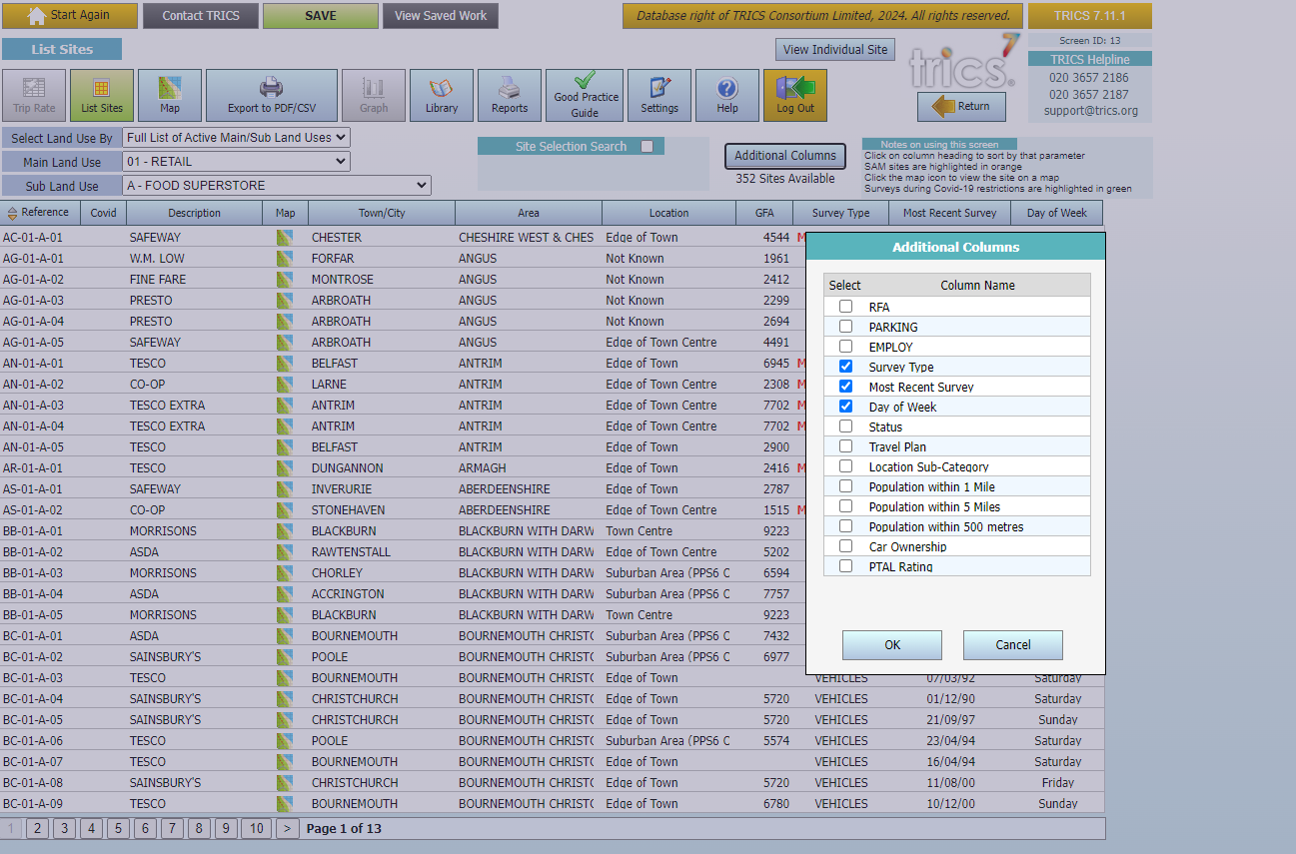
Additional Columns
Notes:
Also, within the List Sites screen, you can add additional columns of information. If you are interested in looking at the parking spaces, employee figures, and various other optional data fields, you can add the columns to the site list and order the list by any column.

Slide 7
TRICS SYSTEM DEMONSTRATION – ADVANCED FEATURES – TRIP RATES
Worked example (Residential)
Number of sites
Different parameters that can be used
Modal Split Percentage Chart
Notes:
We will now move on to a worked example of a trip rate report that includes some more in-depth parameters as well as looking at different charts and features that can be used before creating the report itself.

Slide 8
TRICS SYSTEM DEMONSTRATION – ADVANCED FEATURES – TRIP RATES
Cross-Test facility
Trip Rates Extrapolation feature
Rank Order Scatterplots
Exporting options
Notes:
This will include the Cross-Test facility and the Trip Rate Extrapolation feature, as well as Rank Order Scatterplots and options to export reports and outputs.

Slide 9
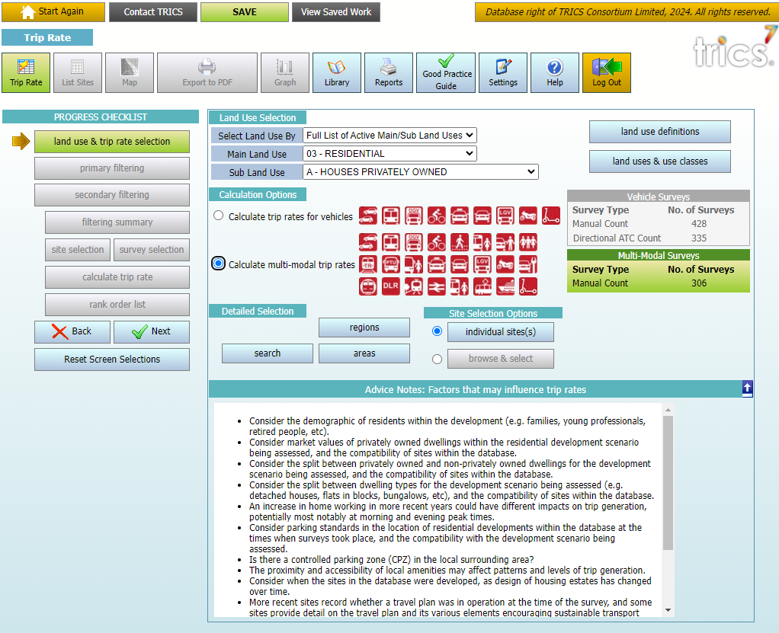
Trip Rate Features
Notes:
We are now looking at features within the Trip Rate Selection and Filtering Process. This is the first screen you see when clicking on the Trip Rate button. The green box on the right shows you how many sites are within the database that fall under the selected land use sub-category. As you can see, within sub-category 03/A (Houses Privately Owned), as we have selected a multi-modal calculation the green box appears, and there are 306 manual count surveys available at this stage. If you require definitions of any of the land use sub-categories, you can click on Land Use Definitions button, with the Land Uses and Use Classes button also available.

Slide 10
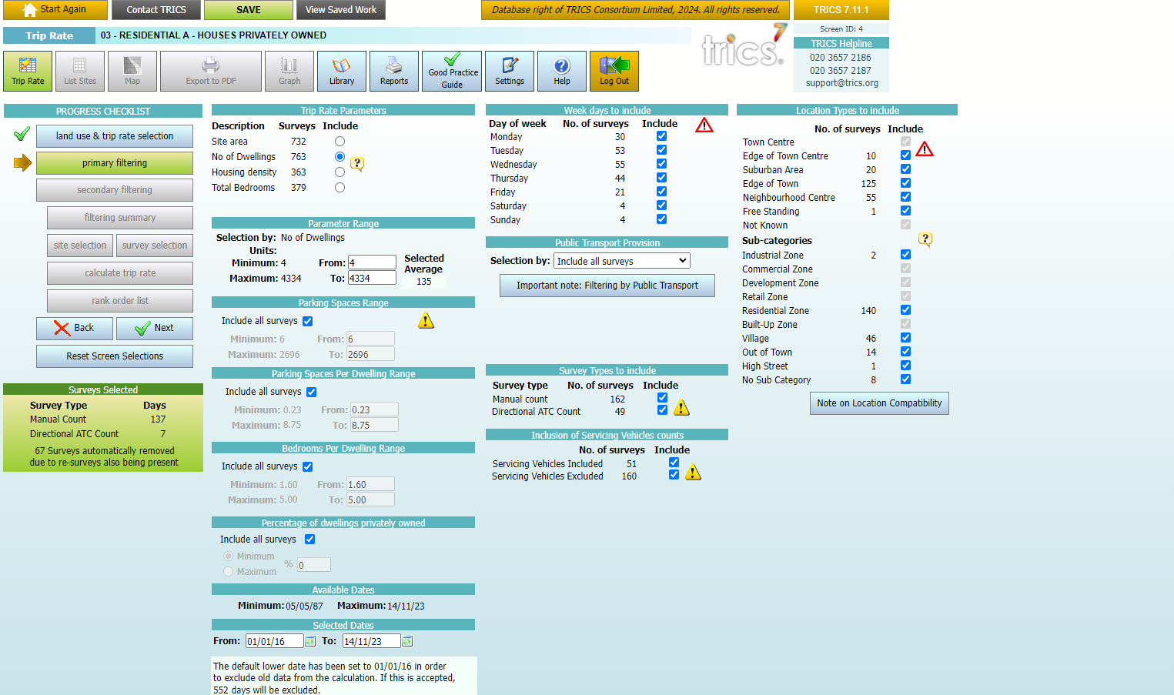
Trip Rate Features - Primary Filtering
Notes:
The next page you will see is the Primary Filtering screen. You will see in the green box that we have gone from 306 available sites down to 125. This is because we have applied the default 8-year cut-off date. This default cut-off date means any sites surveyed before the date in the ‘From’ box will not be included, although this can be adjusted if required. You will also notice the yellow and red exclamation icons. The yellow icon means there is a warning about the selection which you can click on and read, whilst a red icon means the selection as things stand does not comply with the TRICS Good Practice Guide. To find out why, you can click on the icon, and it will give you a brief explanation. For more information, you can review our TRICS Good Practice Guide which Harry will discuss more in his presentation.

Slide 11
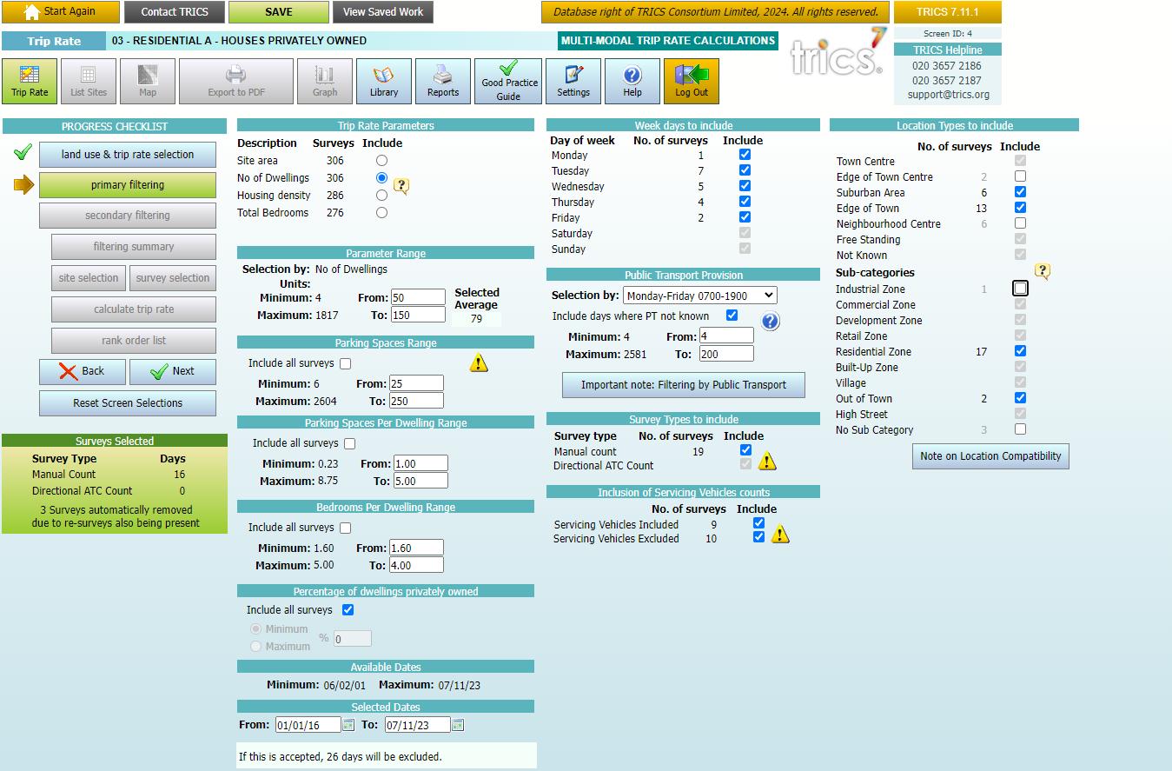
Trip Rate Features - Primary Filtering
Notes:
The first selection to make is the Trip Rate Parameter, with varying options by land use sub-category. For residential surveys, we can choose between Site Area, Number of Dwellings, Housing Density, and Total Bedrooms. The system has automatically selected Number of Dwellings as the default, representing what is viewed as the most often used selection for the land use type. As we have selected Number of Dwellings, we then need to select our range. In our example, we will use 100 Dwellings, so we will set the parameter range from 50 to 150.
Next, we have a selection by the number of parking spaces. You can include all surveys or untick the box and put in your own range. In this example, we have put in a range of 25-250 parking spaces.
The next selection is parking spaces per dwelling. Similarly to parking spaces, you can include all surveys or untick the box to input your range. In this example, we have set a range of 1.00-5.00 spaces per dwelling.
Another selection is bedrooms per dwelling. In our example, we have unticked the ‘Include all surveys’ box and put in a range of 1.60–4.00.
Next, we have the percentage of dwellings privately owned selection. For a site to be within the Privately Owned Houses sub-category, a minimum of 75% of the dwellings must be privately owned. However, if you would like to adjust this to make it anything between 75%-100%, you can untick the “Include all surveys” box and input you own selection. In this example, we have left the default option to include all surveys.
Our next selection is week days to include. If you were to include weekends and weekdays together, a red exclamation mark would appear to indicate a contravention of good practice. However, in our example, we are only looking for weekdays so we will deselect the weekend days.
Next is the public transport provision selection. This can help when looking for sites with high or low public transport within proximity of a development scenario. For our example, we are going to select public transport services on Monday to Friday during 0700-1900, with a minimum of 4 services and a maximum of 200.
If you wish to only include sites with Servicing Vehicle counts included, you can deselect the surveys where they have been excluded.
Next, we can choose our site’s location type. Certain location combinations are deemed incompatible by our Good Practice Guide. If you wish to know what locations are compatible, you can click on the note at the bottom of the screen. In our example, we will choose Suburban Area and Edge of Town as the main location types and for the sub-categories, we will only select Residential Zone and Out of Town.

Slide 12
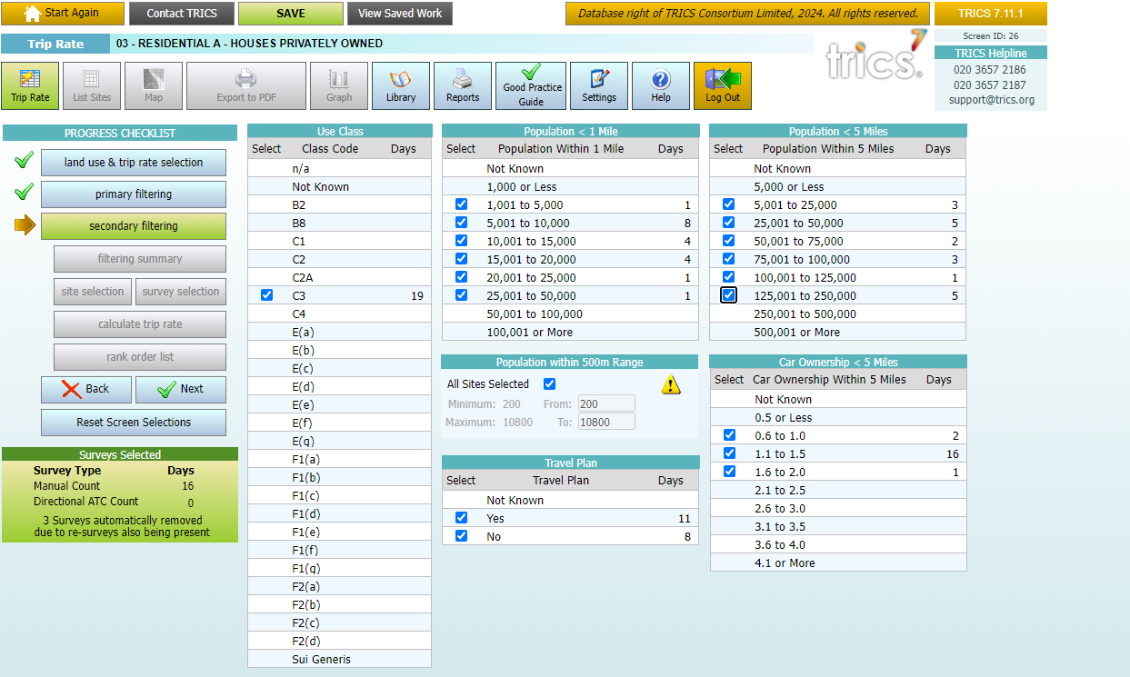
Trip Rate Features - Secondary Filtering
Notes:
On the Secondary Filtering screen, you can choose which Use Classes to include (if there is more than one) as well as choose to deselect certain population and car ownership ranges. In our example, we are going to leave this section with the defaults in place.

Slide 13
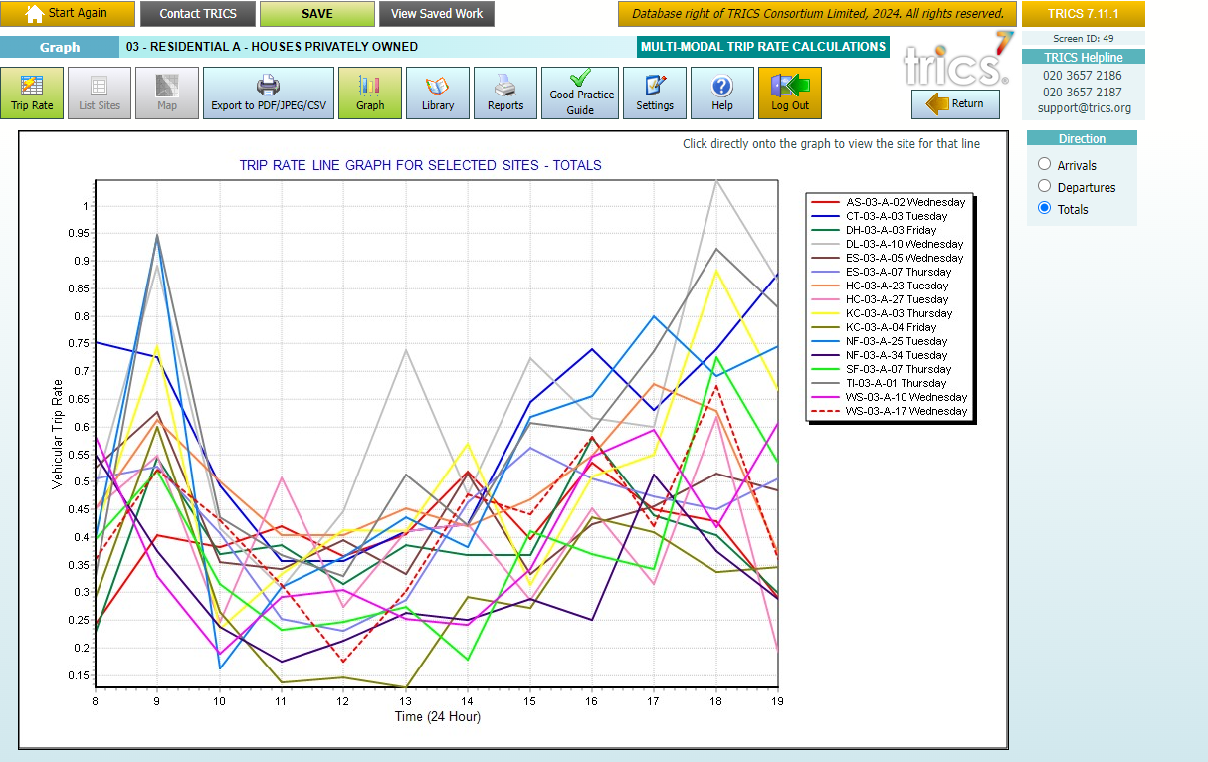
Trip Rate Features – Trip Rate Line Graph
Notes:
On the Survey Selection screen, you will find a Graph button at the top. Clicking on this will present a Trip Rate Line Graph for the selected surveys. This will show the vehicle trips throughout the day for each individual site in the selected set, and if you click on a line within the graph, it will take you to that site record.

Slide 14
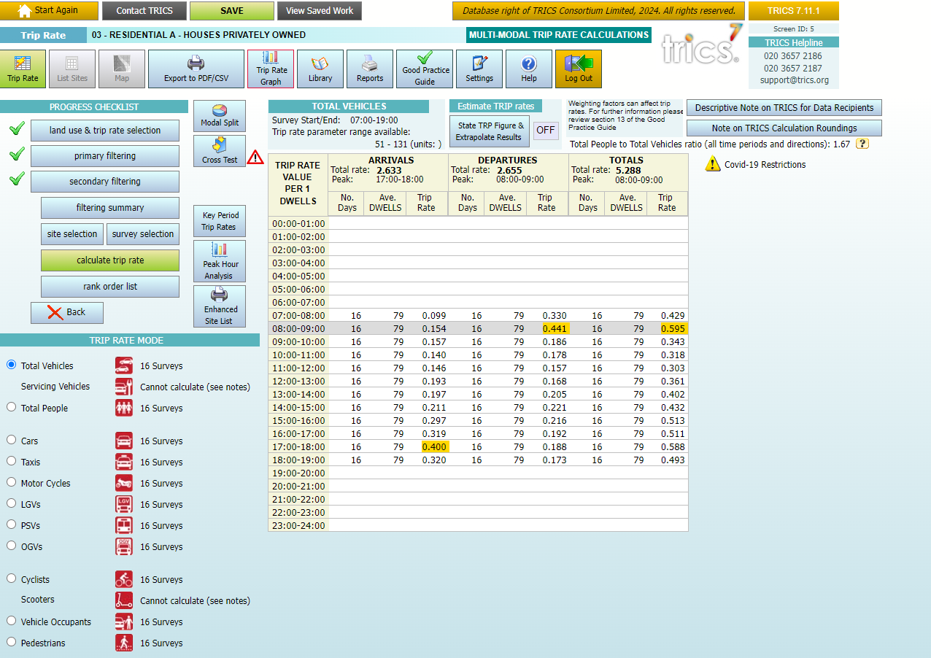
Trip Rate Features – Trip Rate
Notes:
Once you are happy with your filtering, you can click on ‘Calculate Trip Rate’ and you will be taken to the Trip Rate Results screen, where you can view the average (mean) trip rates throughout the day. The default count type shown is Total Vehicles, but you can click on each available count type option to display other trip rates accordingly.

Slide 15
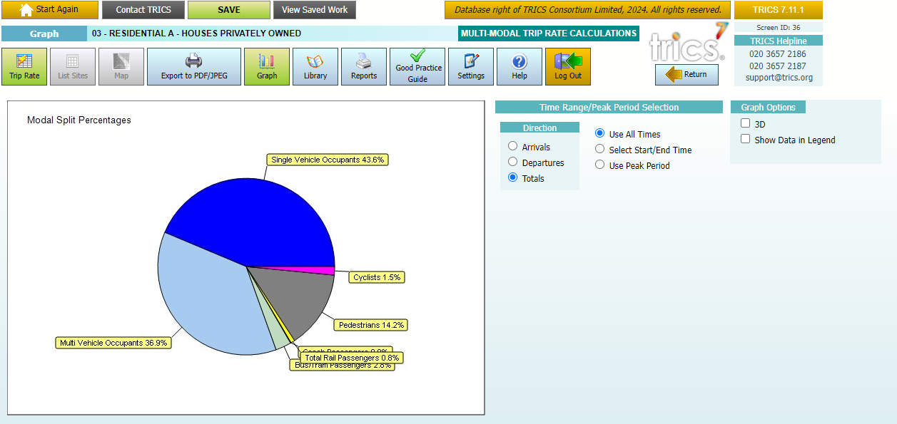
Trip Rate Features – Modal Split Percentage
Notes:
A feature on the Trip Rate Results screen is the Modal Split Chart. This is accessed by clicking on the Modal Split button on the screen. This feature allows you to tailor the chart by direction of flow, and the start and end times (or the peak period).

Slide 16
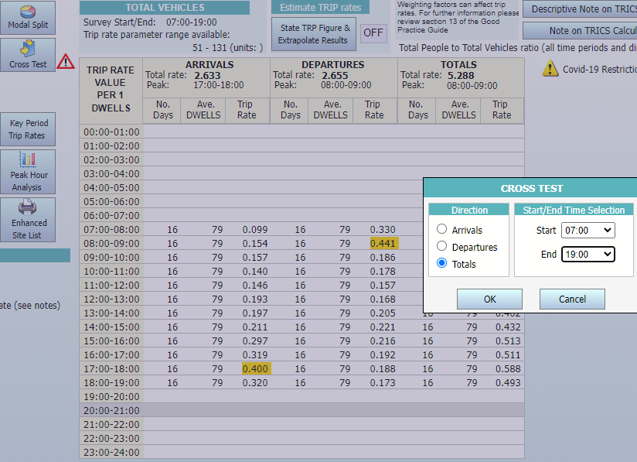
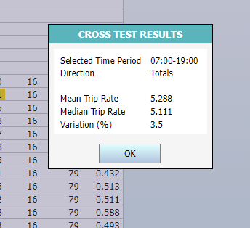
Trip Rate Features – Cross Test
Notes:
You can also see the Cross-Test facility on the Trip Rate Results screen. Once the direction of flow and the start and end times are selected, you can compare the mean and median trip rates of the selected sites from the Results Table and the Rank Order List respectively. This provides a basic assessment of the level of weighting and bias in the mean calculation. Although there is no set figure for acceptance, there is a note that provides further detail about this.

Slide 17
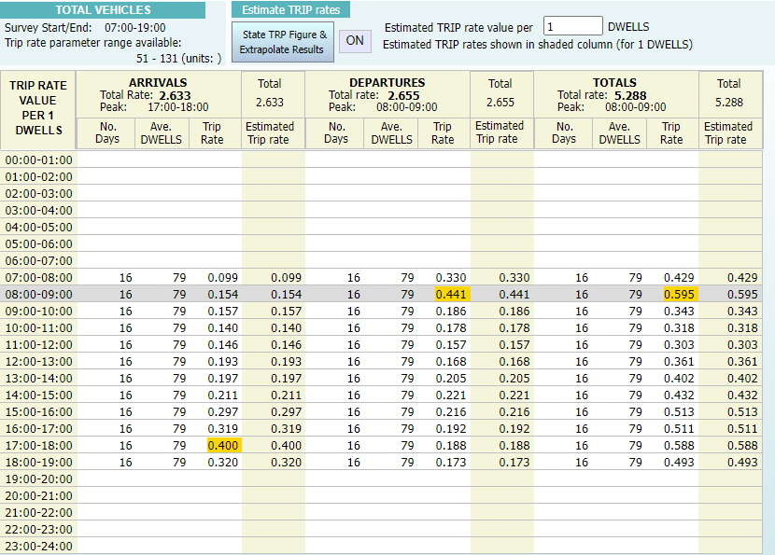
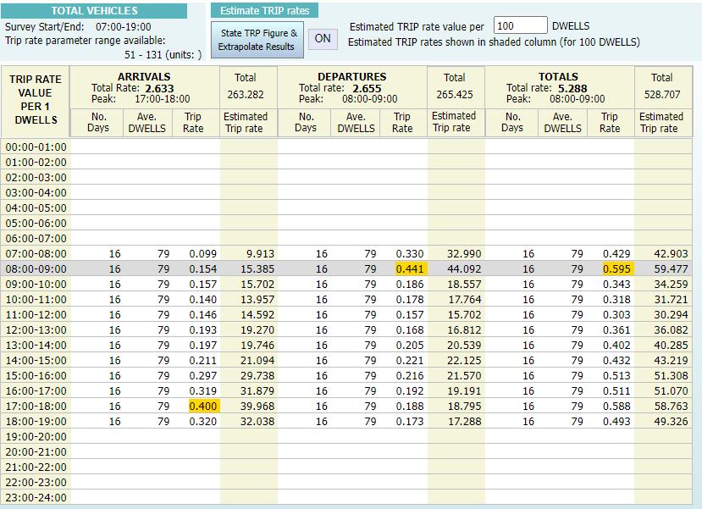
Trip Rate Features – Extrapolate Trip Rates
Notes:
Next, we have the Extrapolate Trip Rates feature. Because we are calculating our trip rates per 1 dwelling, they are currently showing the trips in the Results Table as such. However, we can use the Extrapolate feature to show trip rates by whatever the number of dwellings there are in our development scenario, in this example 100 dwellings. This slide shows a before and after comparison. However, this feature has its limitations and should be used with caution, and our Good Practice Guide provides detail on this, so it is worth referring to.

Slide 18
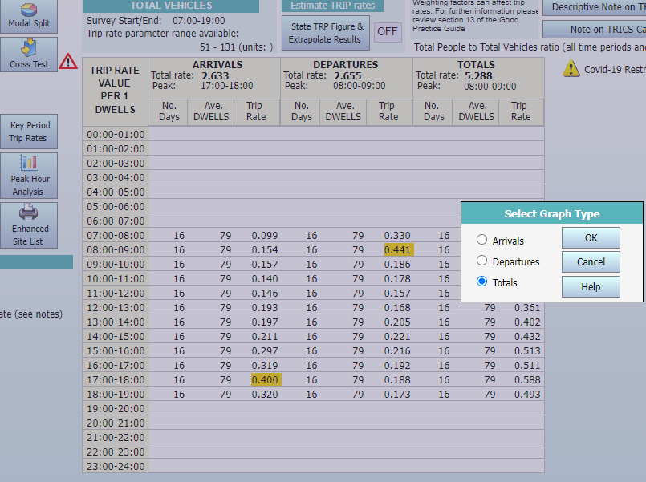
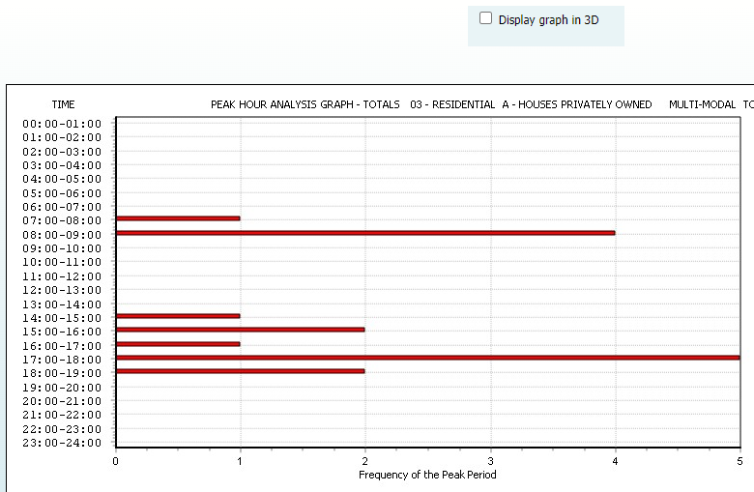
Trip Rate Features - Peak Hour Analysis
Notes:
Another feature that is available is the Peak Hour Analysis graph. Once the direction of flow is selected, you can view a graph that shows you the peak period frequency for the selected set of surveys.

Slide 19
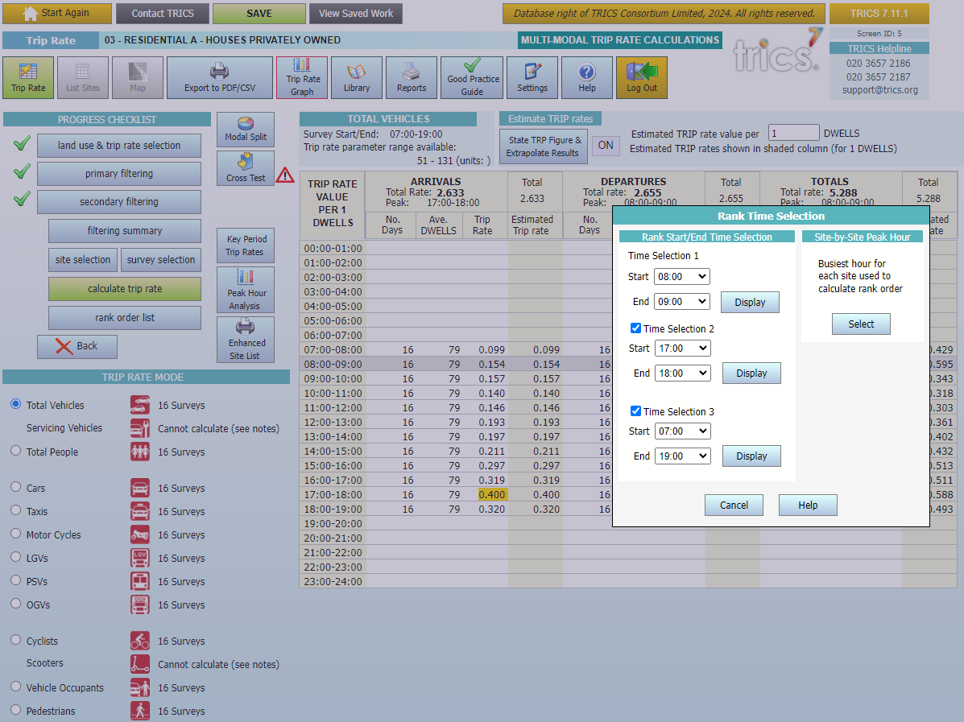
Trip Rate Features – Rank Order List
Notes:
Next, let’s look at the Rank Order List feature. To access this, you need to click on the Rank Order List button and then input the start and end times for up to three separate selections. In this example, we have selected 0800-09:00, 1700-1800, and 0700-1900.

Slide 20
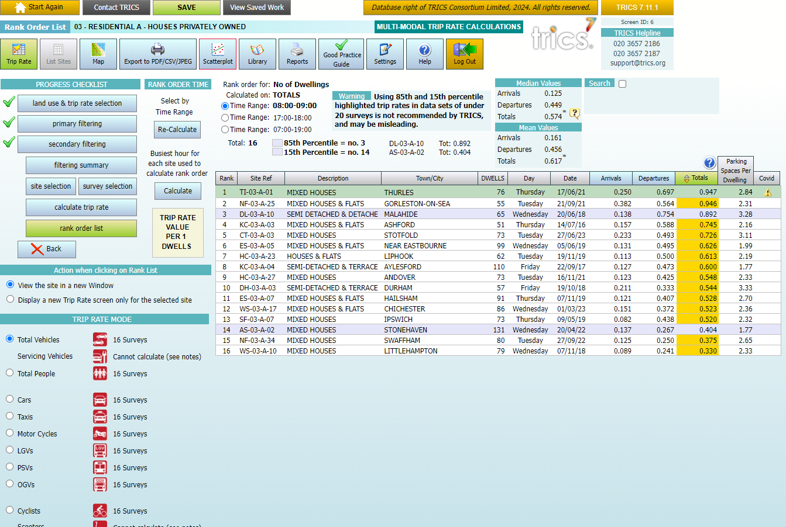
Trip Rate Features – Rank Order List
Notes:
Once the start and end have been selected, you will see the Rank Order List, where you see the individual trip rates per site, ranked in order of relative trip rate intensity, and without any averaging taking place. This also shows the 15th and 85th percentile surveys, should there be enough surveys in the selected set. In our example, we are seeing the Rank Order List for the Total Vehicles count type during 0800-0900., sorted by Totals (arrivals plus departures).

Slide 21
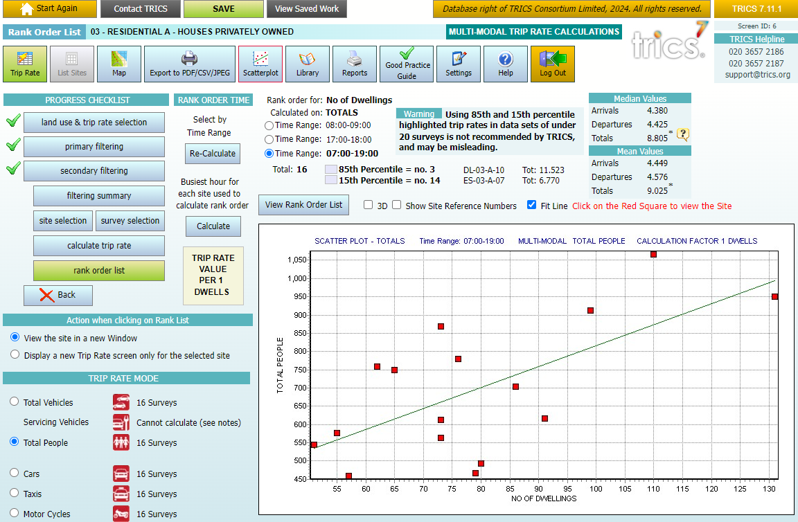
Trip Rate Features – Rank Order Scatterplot
Notes:
The Scatterplot button can be found at the top of the Rank Order List screen. Once the Scatterplot button is clicked, you can choose what count type you wish to view the Scatterplot by. In our example, we can see the Scatterplot for the Total People count type for the period 0700-1900. Also note that the Scatterplot shows the selected Trip Rate Calculation Parameter on the x-axis with the trip rates on the y-axis. You can access individual site records that the red boxes represent by clicking on them.

Slide 22
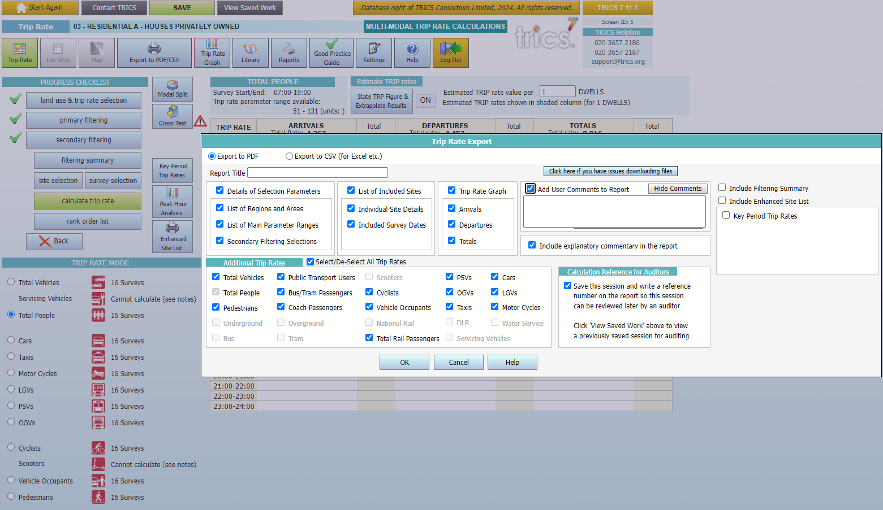
Trip Rate Features – Export Options
Notes:
Once you are happy with your results you can export the reports. The Trip Rate Report can be exported to either a PDF or a CSV (Excel) file. For the PDF format you can select to include Trip Rate Graphs, select or deselect count types, and add user comments. You can also include the filtering summary and an enhanced site list.

Slide 23
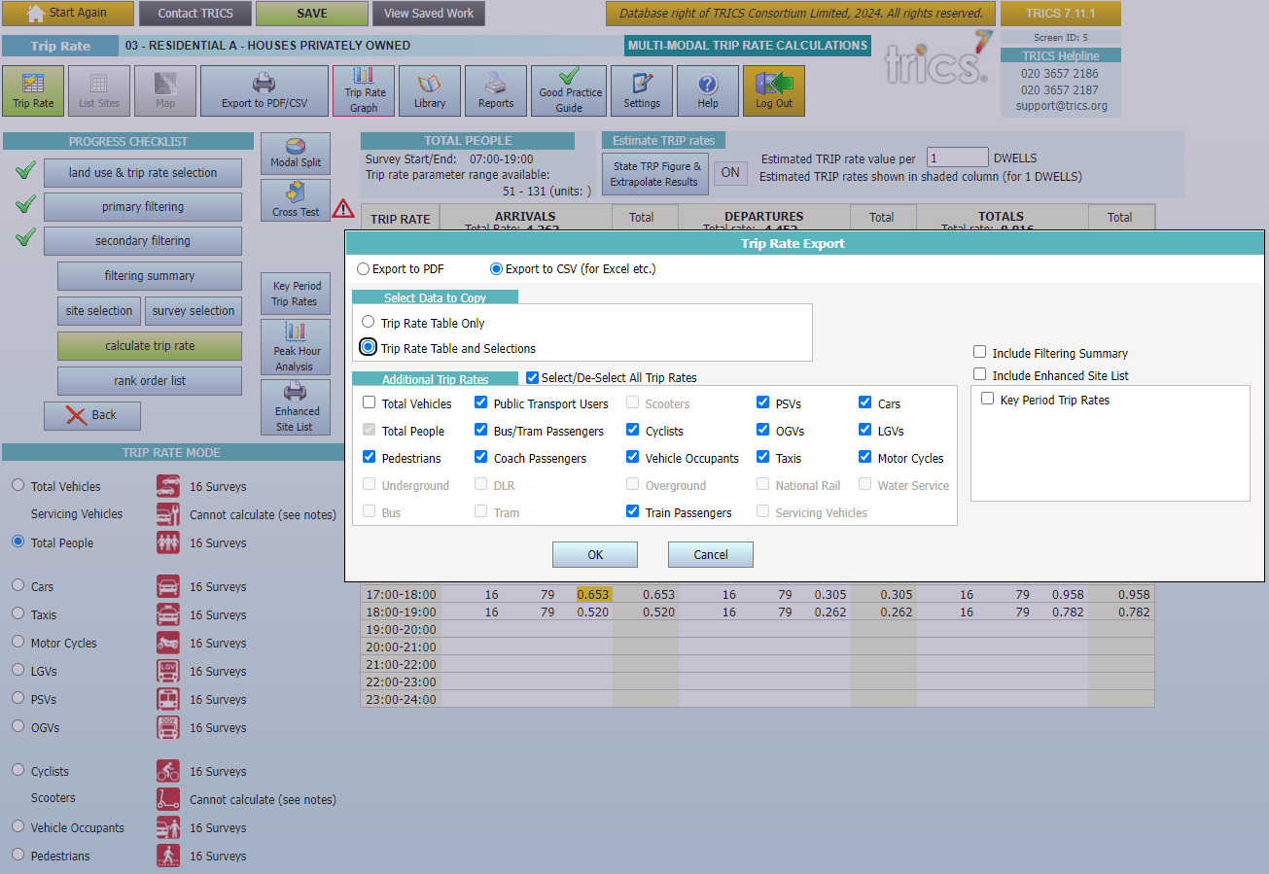
Trip Rate Features – Export Options
Notes:
With CSV exporting, you can select or deselect count types, as well as include the filtering summary, enhanced site list and key period trip rates.

Slide 24
TRICS SYSTEM DEMONSTRATION – ADVANCED FEATURES – TRAVEL PLAN MONITORING REPORT
Site details
Travel Plan implementation
Travel Plan mode splits & targets/objectives
Travel Plan features
Survey results
Notes:
I will complete this presentation with a brief overview of the Travel Plan Monitoring Report feature, as well as a worked demonstration of how to produce a TPMR output, which includes user defined mode split pie charts and trip rate calculations.

Slide 25
EXAMPLES OF TPMR USE
Notes:
We are going to look at two different examples of different TRICS land uses together, and what you will see when using the TPMR feature in both cases. One example is for a residential site and the other is for a non-residential site, in our case a hotel.

Slide 26
SITE DETAILS (RESIDENTIAL LAND USE)
Notes:
I will take you through both examples. You can see that on the left of this screen are the buttons for the six sub-sections of the TPMR facility. Let’s start by looking at the Site Details sub-section. This is a quick summary of key information on the residential site’s location, development and on-site parking. As you can see, as this is a residential site, the development section includes a table breaking down the residential unit types of all occupied dwellings at the time of the survey, so we can see the number of detached houses, semi-detached houses, flats, etc, also broken down by privately owned and non-privately owned dwellings. You can also see that on-site parking is broken down by parking space types.

Slide 27
SITE DETAILS (NON-RESIDENTIAL LAND USE)
Notes:
Here is the Site Details sub-section for a non-residential site (in this case a hotel). The key differences from the residential development are in the development and the parking details information. You can see that instead of stating the different types of residential units we have employee information, and instead of different types of on-site residential parking types such as driveways and garages, we have a non-residential breakdown including employee spaces, customer spaces, OGV spaces, etc.

Slide 28
TRAVEL PLAN IMPLEMENTATION
(ALL LAND USES)
Notes:
The Travel Plan Implementation sub-section of the TPMR facility includes information on the type of travel plan at the site and whether there is a Travel Plan Co-ordinator who works on the travel plan’s development and implementation. It also provides information on when the travel plan was implemented and any developer initiatives (as per planning agreements). Note that the format of this sub-section is identical for both residential and non-residential sites.

Slide 29
TRAVEL PLAN MODE SPLITS & TARGETS/OBJECTIVES (RESIDENTIAL LAND USE)
Notes:
The Travel Plan Mode Splits & Targets/Objectives sub-section includes information on the pre-travel plan mode splits and travel plan mode split targets, plus the travel plan’s objectives and specific (commented) targets, and the travel plan target groups. The differences between residential and non-residential land uses are in the travel plan target groups. You can see the residential site’s target groups in this example, with these split between residents, visitors, all site users and other.

Slide 30
TRAVEL PLAN MODE SPLITS & TARGETS/OBJECTIVES (NON-RESIDENTIAL LAND USES)
Notes:
If you look at the travel plan target groups for a non-residential site, you’ll see the split of staff, visitors, customers, students, patients, all other site users and other. What target group types are included within a travel plan will vary, depending on the land use sub-category. In this example of a hotel, we see that staff, visitors and customers are target groups, but if we were to look at a GP surgery you might find that patients are a target group, or in a school example, students might be. Note that for SAM surveys undertaken before 2023, all target groups are displayed, whereas since the Travel Plan data section was reviewed and split in 2022, we now have the different target group splits between residential and non-residential surveys from that point onwards, providing much improved context.

Slide 31
TRAVEL PLAN FEATURES
Summarises all individual travel plan elements along with implementation dates and commentary.
It is broken down into the following categories:
  Cycling
  Incentives (called Financial pre-2023)
  Public Transport
  Marketing Suite/Shuttle Bus (depending on whether the site is residential or non-residential)
Notes:
The Travel Plan Features sub-section is a larger section of information which summarises all individual travel plan elements, providing implementation dates and commentary where available. It is broken down into the following sub-areas: Cycling, Incentives (which is called Financial for all surveys pre-2023), Public Transport, and Marketing Suite or Shuttle Bus (depending on whether the site is residential or non-residential). This sub-section extracts the data that is contained within the various sub-sections of the Travel Plan data section for the site, handily placed amongst the other sub-sections to provide good detail and context for users operating the TPMR facility. Due to the amount of information in this sub-section, I won’t go into every difference between residential and non-residential sites, but one example is the information shown in the Cycling area of this sub-section. For residential sites, the information shown includes whether there is on-site storage for cycles at houses and flats, as well as if there are any cycle routes through or around the site to connect it to local amenities. With non-residential sites, such as the hotel we have been looking at, information regarding the availability of facilities such as showers, lockers and changing rooms is displayed, as well as other information such as events that encourage staff members to cycle into work, etc.

Slide 32
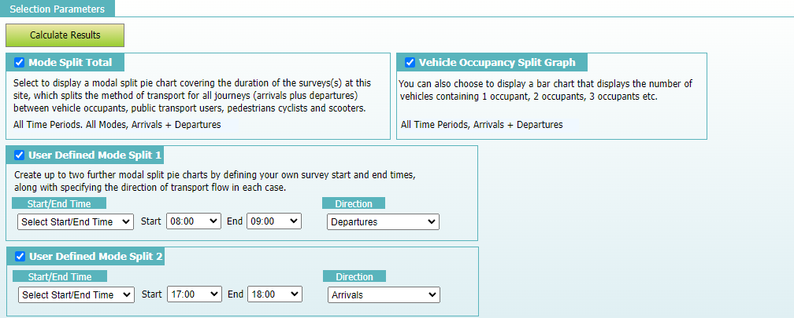


SELECTION PARAMETERS
Notes:
We now move on to the Selection Parameters sub-section, where users can apply their criteria for calculating a series of trip rate results and mode split pie charts, plus the inclusion of the vehicle occupancy split chart and, if applicable, the comparison option for sites that have been surveyed on more than one occasion. Here you can see the first half of the Selection Parameters sub-section. The first selection is the Mode Split Total. Clicking on the tick box for this selection will include a mode split pie chart covering the duration of the survey at the site in both directions combined (arrivals plus departures) across all time periods. Depending on when the survey was undertaken, the mode split pie chart will be split by vehicle occupants (sub-split by single vehicle occupants and multi vehicle occupants), cyclists, scooters (available for surveys undertaken from 2022 onwards), pedestrians and public transport users. Next is the Vehicle Occupancy Split Graph. Clicking on the tick box for this selection will include the graph covering the duration of the survey at the site for both directions combined (arrivals plus departures). This chart will display the number of vehicles with 1 occupant, 2 occupants, 3 occupants etc, up to 7 occupants. Note that this chart is the same that can be accessed for the site on its Vehicle Occupants count screen and will exclude drivers of vehicles picking up/dropping off people at the site. Then we have up to two optional User Defined Mode Splits. In the first set of drop-down options, you can either choose a specific start and end time, use all survey periods, or use the peak (busiest) survey period, and the final selection is the direction of flow. In our example we have a residential site, so we have decided to calculate the departures mode split for the 0800-0900 period and the arrival mode split for the 1700-1800 period.

Slide 33
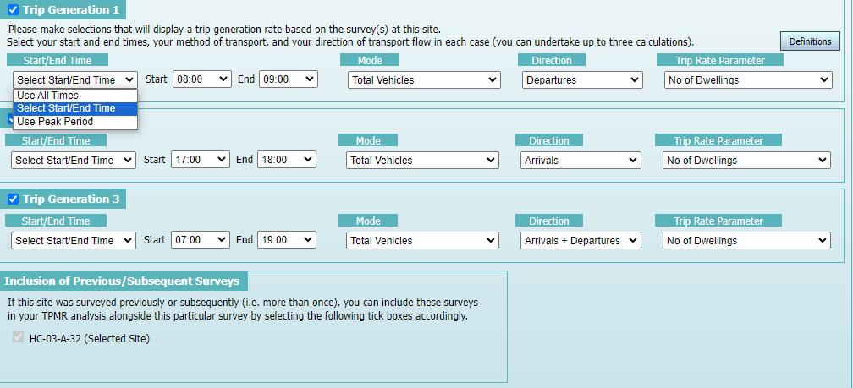
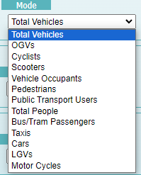

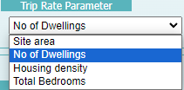
SELECTION PARAMETERS
Notes:
We then have our trip generation selections. These allow the inclusion of up to three user-defined trip rate calculations. Note that the first selection has its tick box ticked by default and initially includes the full survey duration, but for all three selections users can decide the start and end times (or peak periods), count mode, direction of flow and the trip rate calculation parameter to be used. In our example (for a residential site), we have decided to undertake calculations for total vehicle departures during 0800-0900, using the number of dwellings calculation parameter option. We have also decided to calculate arrivals for 1700-1800, and arrivals plus departures for the total survey duration of 0700-1900. On this screen we also have the inclusion of previous/subsequent surveys for comparative purposes. If the selected SAM survey was a re-survey of a previously surveyed site in TRICS, or if it was itself resurveyed by a subsequent count, then there is the option to include the same calculations that have been user-defined for each associated survey. As you can see, this site doesn’t have this option as it has only been surveyed once.

Slide 34
Notes:
At the top of the Selection Parameters screen you will see a Calculate Results button. Once you are happy with your selections, clicking on this button will populate the Survey Results sub-section and will take you to it. In our example you can see the results of the trip rate calculations we selected and the first of our mode split pie charts. You can also see at the top of the Survey Results screen that there is a button called Generate Travel Plan Monitoring Report PDF with Commentary. When you click on this, the Travel Plan Monitoring Report is produced in PDF format. You may also want to add your own paragraph of commentary to the report, and this can be done by selecting the tick box that appears called Add User Comments to Report. Adding your comments and clicking on the OK button will ensure that this text is included in the report.

Slide 35
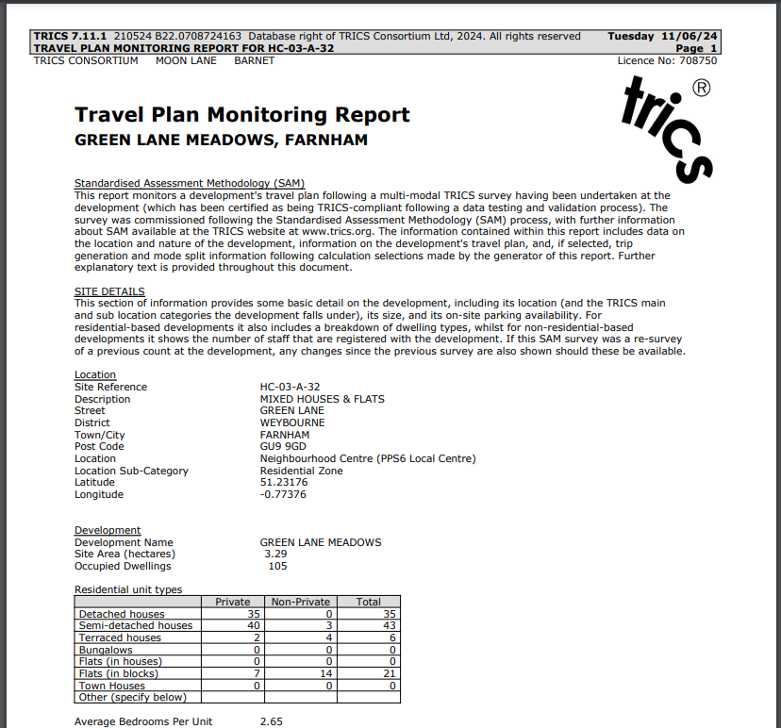
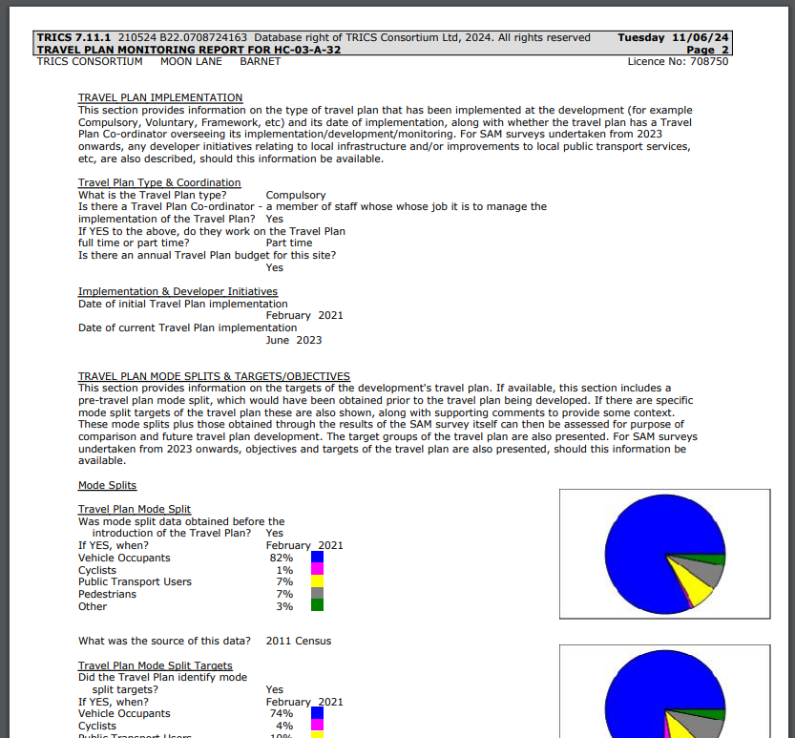
Notes:
To finish, here is an example of what a TPMR PDF output looks like. Note that it includes plenty of explanatory commentary, meaning that it is a quickly-generated report that is suitable for people who may not be familiar with TRICS. The TPMR facility was fully reviewed and updated in 2023, and this is also reflected in the PDF outputs.

